Slide 1

Bioengineering Senior Design | Spring 2017
Aras Fanuscu, Andrea Frank, David Hernandez, Angel Xiao

Slide 2


Slide 3
The Numbers
65%
38%
23,000
people in the US sprain their ankles every day
of people don’t complete the rehabilitation process
of people experience recurrence of their injury

Slide 4
The Rehabilitation Process
The SockRocker Rehabilitation Device
Initial Treatment
Rehabilitation
Functional Strengthening

Slide 5
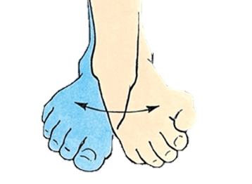
The Rehabilitation Process
The SockRocker Rehabilitation Device
Initial Treatment
Inversion/Eversion

Slide 6
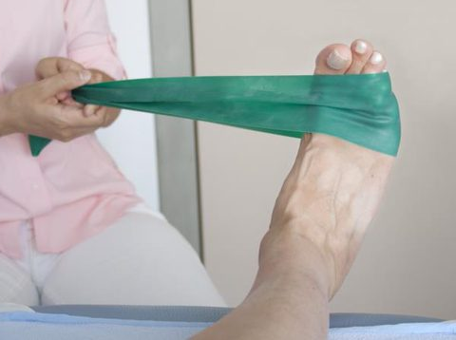
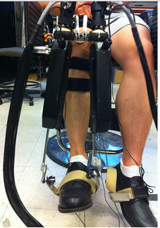
Bridging the Gap

Slide 7


Slide 8



We set three main Goals
Effective rehabilitation
Targeted muscle therapy
Active rehabilitation
Personalization
Physician input
Variable resistance
Accessibility
Universal design
Useful in many contexts

Slide 9
The Design Process
Design Drivers
The SockRocker
Physiological Constraints
Range of Motion
Variable Resistance
Performance Requirements
Physician Control
Experienced Professional Input
Comfort

Slide 10


Slide 11
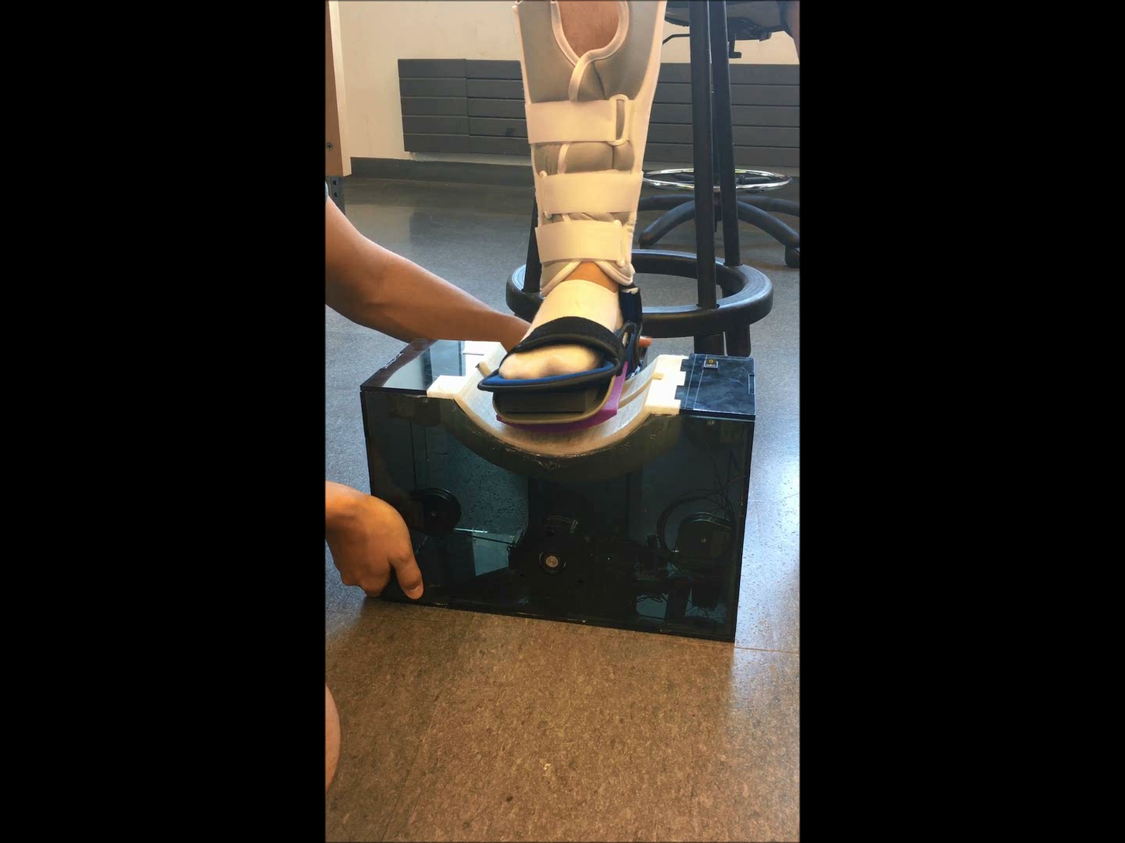
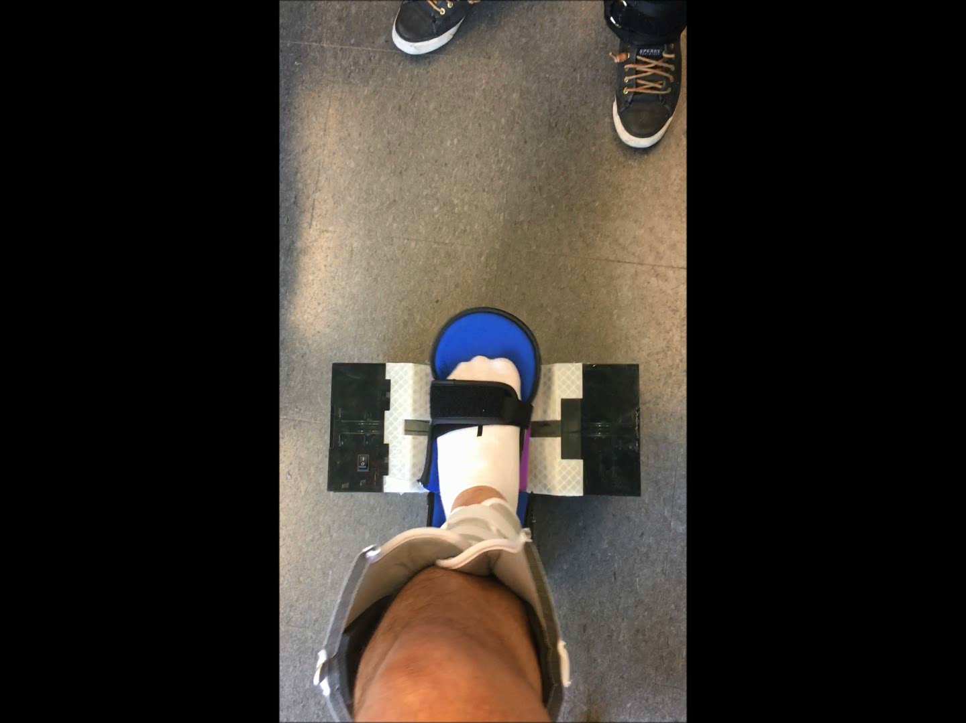

SR

Slide 12

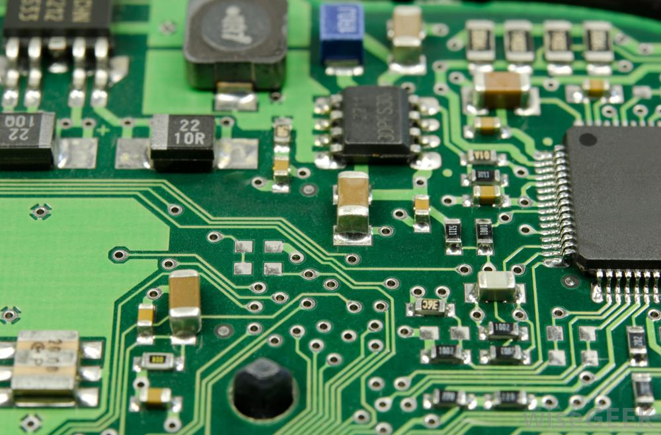
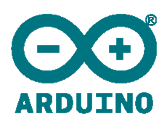

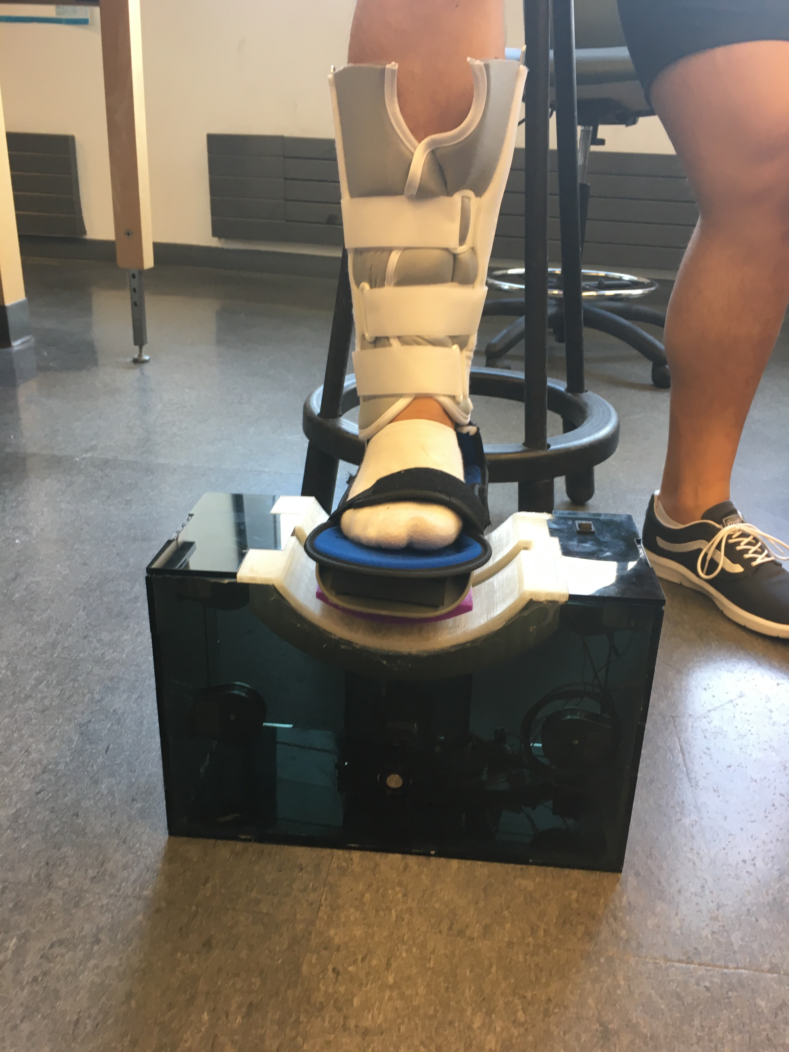
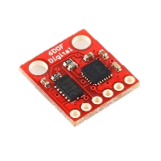
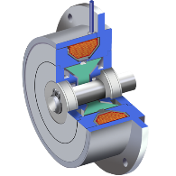
Physician-patient Information Flow
Arduino Microcontroller sends Signal
Varying current input to brake
Physician Input (Matlab GUI)
Patient progress tracked and recorded
Patient carries out assigned training
Brake generates resistive force

Slide 13
Physician-patient Information Flow
Arduino Microcontroller sends Signal
Varying current input to brake
Physician Input (Matlab GUI)
Patient progress tracked and recorded
Patient carries out assigned training
Brake generates resistive force

Slide 14
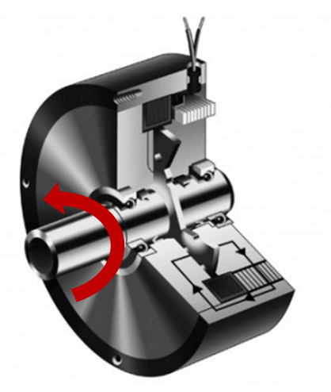
Variable resistance system
Physician Input (Matlab GUI)
Varying current input to brake
Varying current modulates the brake’s resistance to rotation

Slide 15
Physician-patient Information Flow
Arduino Microcontroller Sends PWM Signal
Varying current input to brake
Physician Input (Matlab GUI)
Patient progress tracked and recorded
Patient carries out assigned training
Brake generates resistive force

Slide 16
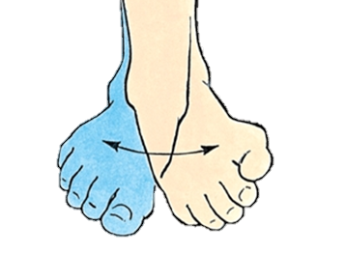
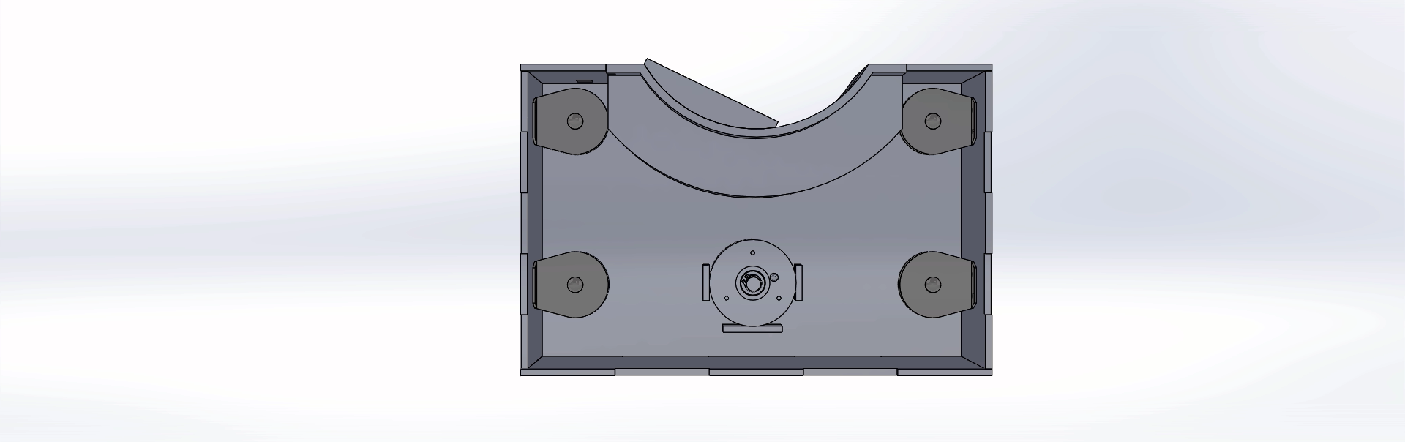
Our track ensures Targeted Therapy
Isolates inversion and eversion motions
Shape determined by ankle sizes and motion
Patient carries out assigned training

Slide 17


Slide 18

Effective rehabilitation
Torque range
0 — 20 N-m
0.8— 5.3 N-m
Torque resolution
0.5 N-m
0.09 N-m
Range of Motion
-23º — 12º
-30º — 30º

Slide 19
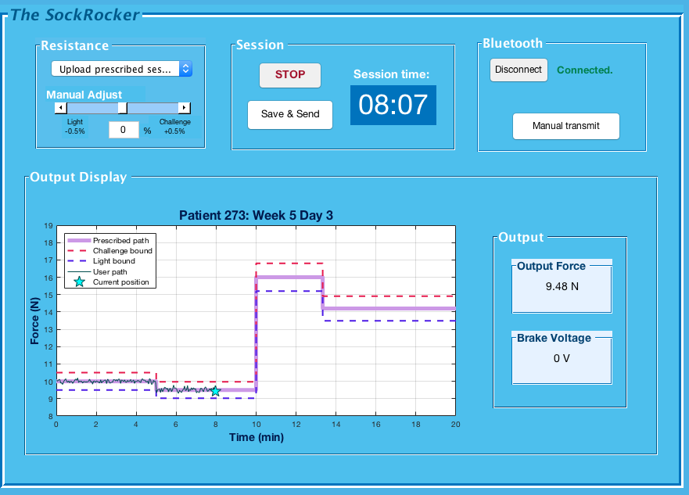
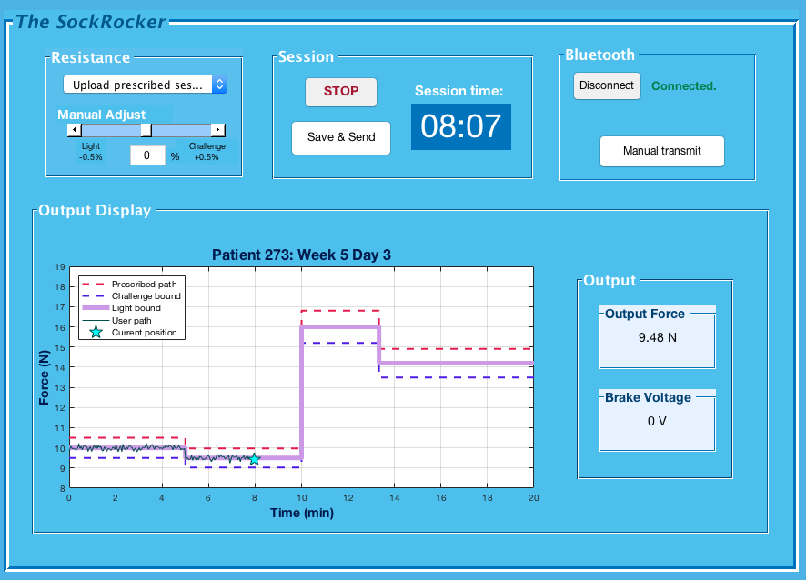
Personalized rehabilitation
Physician prescribed
force profiles
Save & Send
Patient customization
Monitor progress

Slide 20
Increasing Accessibility to care
Ease of
Acquisition
Ease of
Usage
Low Cost
$360 per device
Universal Design
Fits any foot size
Portable
<15lb, no external wires
Human factors
Familiar interface
Low Power
24V battery: 1 month
Comfort
4.8/5 rating (pilot study)

Slide 21


Slide 22
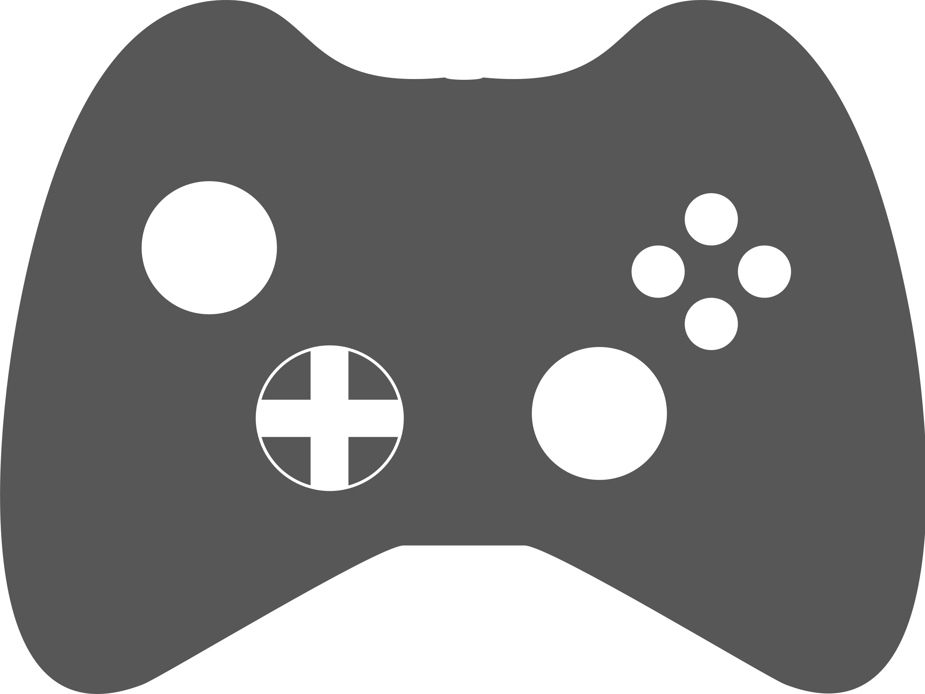


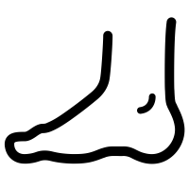
We see a bright future for our device
Develop activities to improve compliance
Clinical testing to affirm long term efficacy
Incorporate more sophisticated controls
Improve range of feet sizes and forces

Slide 23

Our Impact
$900 MM / yr
$360/device
7.2 M
injuries
900,000
ER visits
$1000 per visit

Slide 24


Our Impact
“ Millions of Americans each year are incompletely rehabilitated and prone to re-injury, due to lack of effective exercise equipment to specifically strengthen key ankle stabilizer muscles.
This prototype device illustrates a way to address this unfortunate gap in our clinical rehabilitation management of [these] persons.”
Dr. Timothy Dillingham, MD, MS
Chair, Dept. of Physical Medicine and Rehabilitation

Slide 25

Thank you to the BE Department for all their support!
Special Thanks to:
Dr. Timothy Dillingham
Dr. Michael Rizk
Dr. Susan Marguiles
Sevile Mannickarottu
Daniel Pak

Slide 26


Slide 27
Appendix
Assembly Drawing
Circuit Diagram
Overview Images
Force Calibration
Track Details
Detailed Costs
Force Interfaces
References

Slide 28
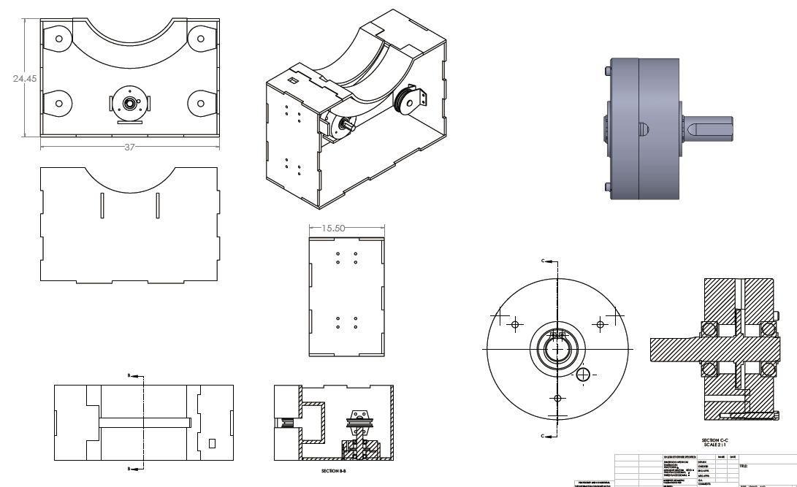

Assembly Drawing

Slide 29
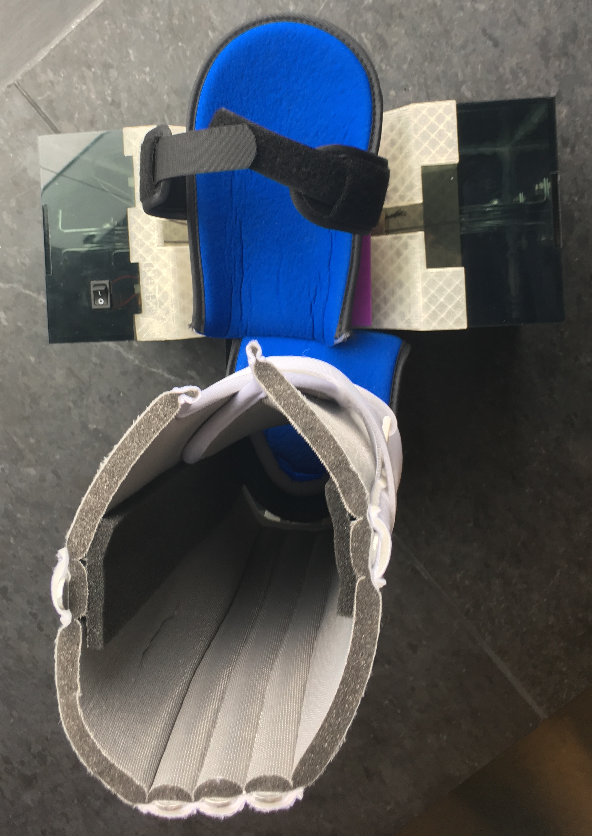
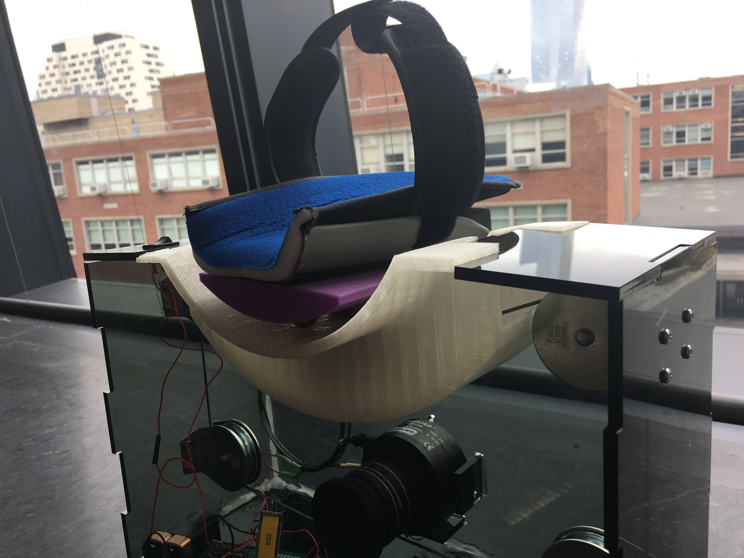
Overview Images

Slide 30
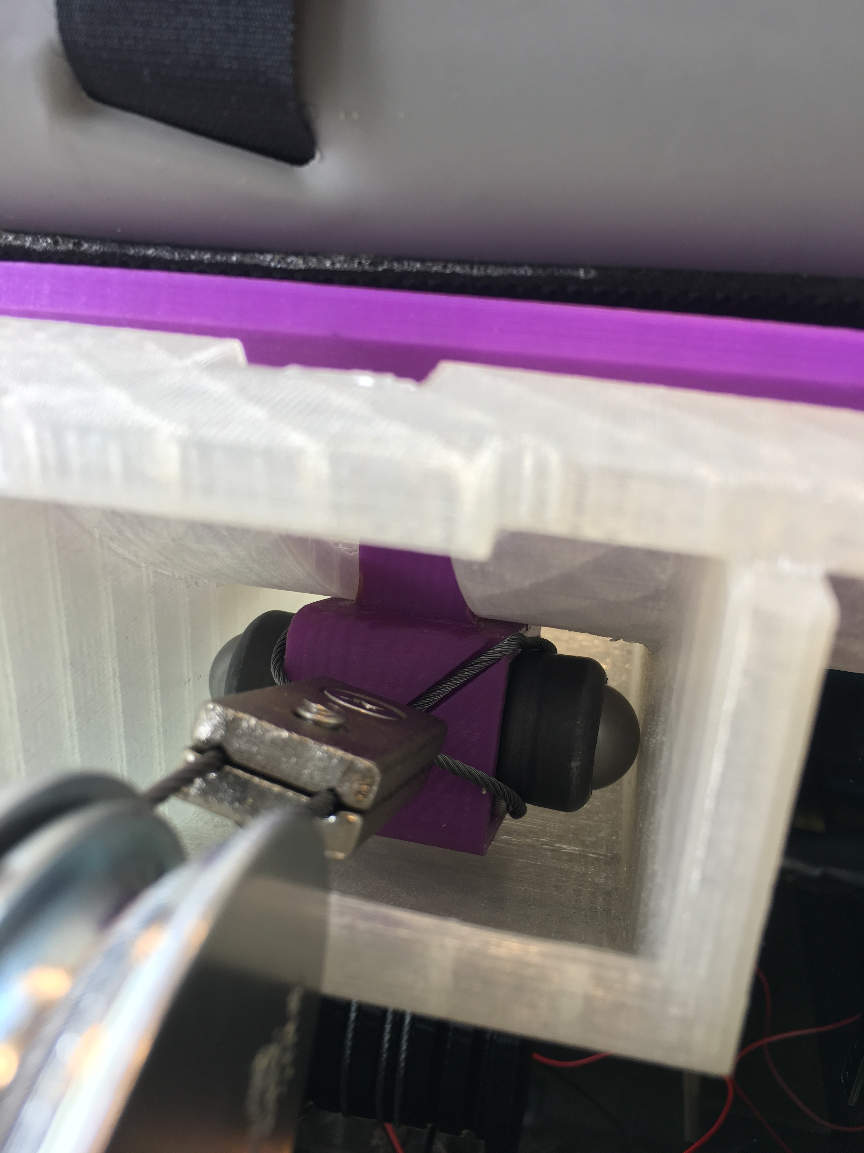
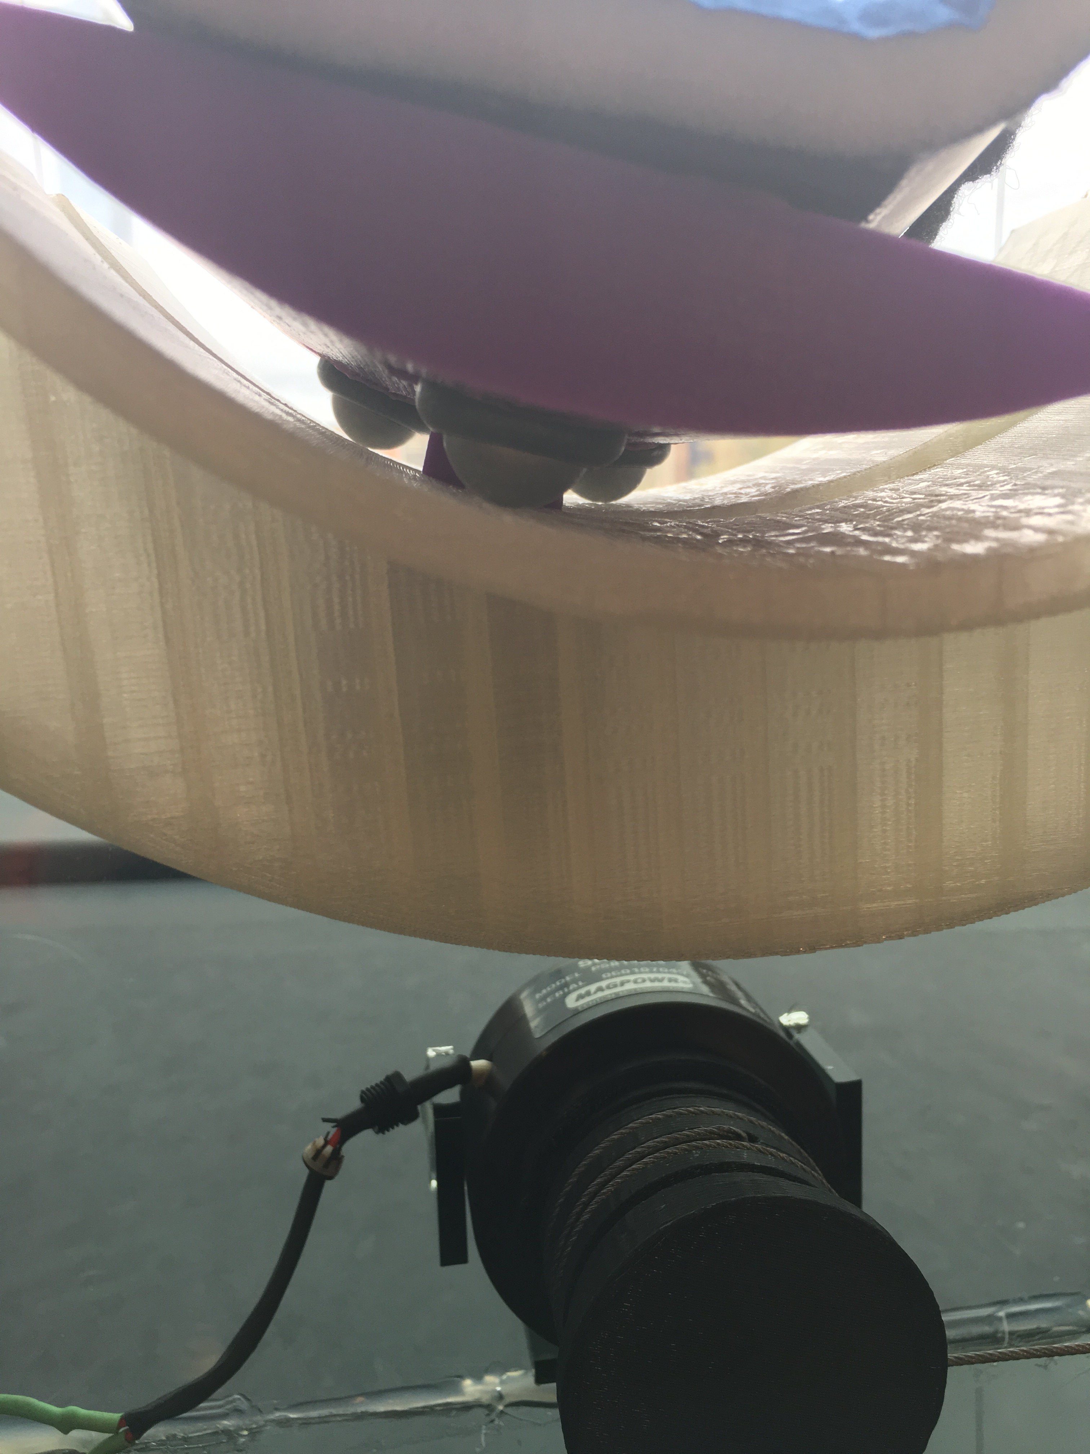
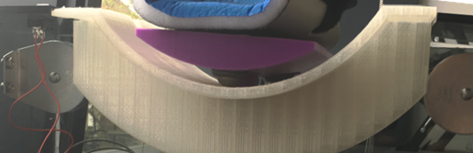
Track Details

Slide 31
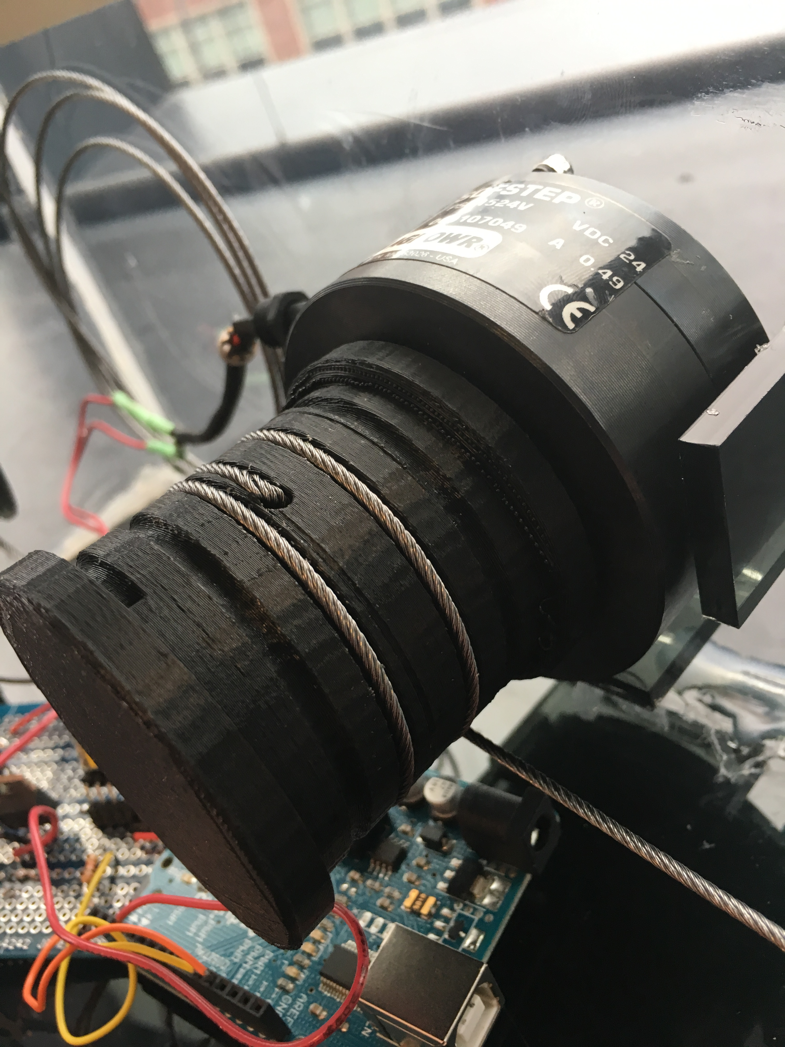
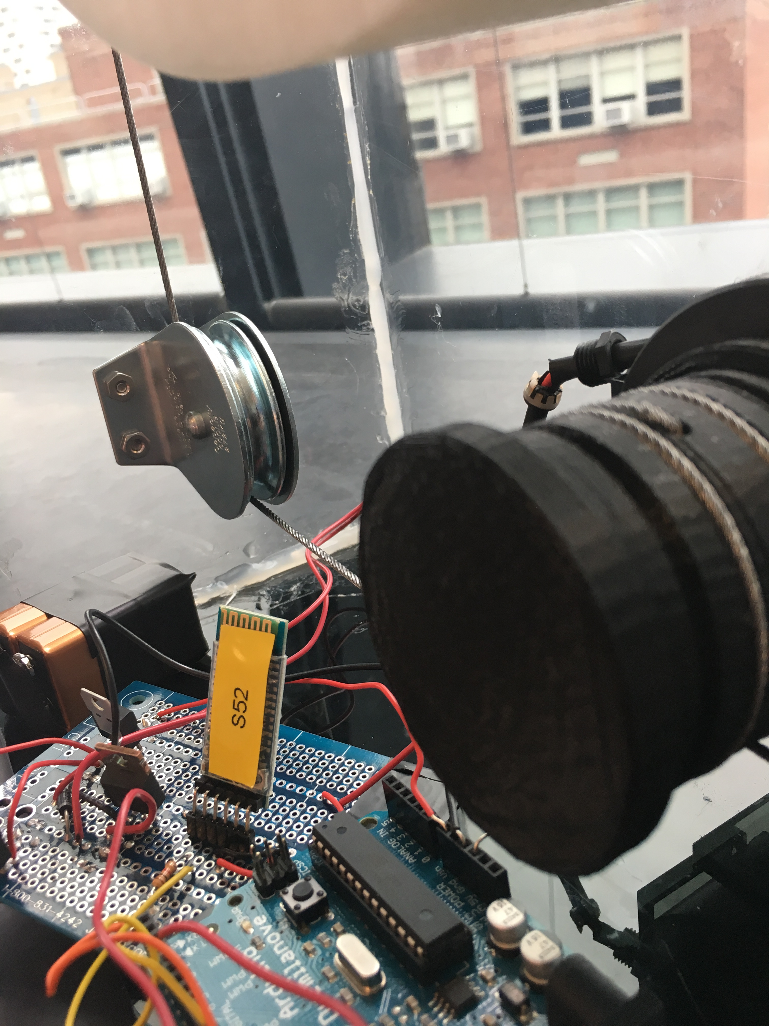
Force Interfaces

Slide 32
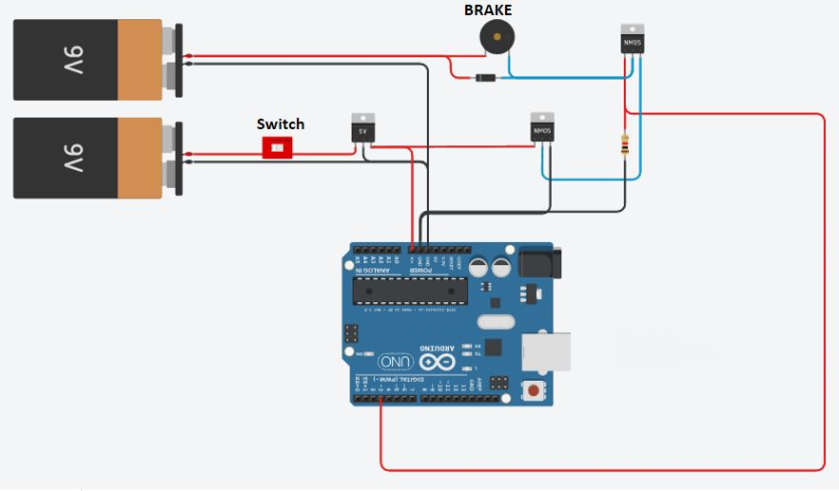
Circuit Diagram
Not shown: Bluetooth Receiver Section

Slide 34
Cost Breakdown
Electronics | Qty | Cost per Unit | Total Cost
Arduino | 2 | $17.99 | $35.98
Bluetooth Set | 2 | $4 | $8
Brake | 1 | $130.35 | $130.35
9V Batteries | 2 | $4.5 | $9
Misc. Electronics | 1 | $1 | $1
SUM: |  |  | $184.33
Mechanical | Qty | Cost per Unit | Total Cost
Pulleys | 4 | $7.02 | $28.08
Wire Rope | 3 | $8.39 | $25.17
Ball Bearings | 5 | $6.03 | $30.15
Clamps | 2 | $5.28 | $10.56
Foot Piece | 1 | $20.50 | $20.50
Leg Piece | 1 | $30.72 | $30.72
3D Printing Costs | 586.02 | $0.05 | $31.25
Laser Cut Costs | 4 | $18.80 | $75.20
SUM |  |  | $176.4344
Grand Total: 360.7644

Slide 35
References
Konradsen, L., Olesen, S., & Hansen, H. M. (1998). Ankle sensorimotor control and eversion strength after acute ankle inversion injuries. The American journal of sports medicine, 26(1), 72-77.
Osteopathicinfo. Melbourne Osteopathy Group - Osteopath Fitzroy North. 23 Jan 2017. Retrieved from: <http://www.osteoinfo.com.au/self-management/management-of-the-ankle-foot>.
Bernier, J. N., Perrin, D. H., & Rijke, A. (1997). Effect of unilateral functional instability of the ankle on postural sway and inversion and eversion strength. Journal of Athletic Training, 32(3), 226.
Goncalves, F. D. (2005). Characterizing the behavior of magnetorheological fluids at high velocities and high shear rates (Doctoral dissertation, Virginia Tech).
Lord Rheonetic Magnetically Responsive Technology, Hydrocarbon-Based MR Fluid MRF-132LD, Product Bulletin, 2002.
http://cruxcrush.com/2014/11/11/climber-problems-ankle-injury/
http://www.laboratoryequipment.com/news/2013/10/anklebot-can-aid-stroke-rehab
http://medicalrecruiting.com/wp-content/uploads/2014/02/Physician-at-computer.jpg
http://images.wisegeek.com/circuit-board.jpg
http://www.electric-brake.com/img/magnetic-partice-brake.png
http://skpang.co.uk/catalog/images/sensors/accelerometer/10121-01.jpg
https://www.ncbi.nlm.nih.gov/pmc/articles/PMC3183932/

